Slide 1
HW 8
Group 3
Presenter 張君豪

Slide 2
TextComposition

Slide 3
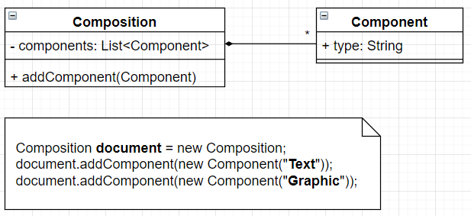
Requirements Statement 1
The Composition class maintains a collection of Component instances, which represent text and graphical elements in a document.

Slide 4
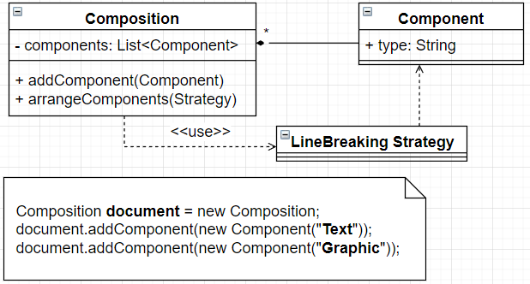
Requirements Statement 2
A composition arranges component objects into lines using a linebreaking strategy.

Slide 5
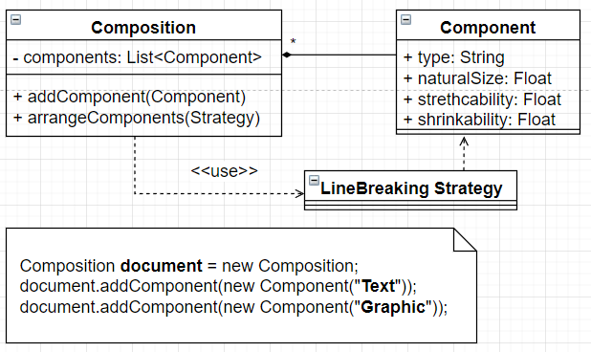
Requirements Statement 3
Each component has an associated natural size, stretchability, and shrinkability.

Slide 6
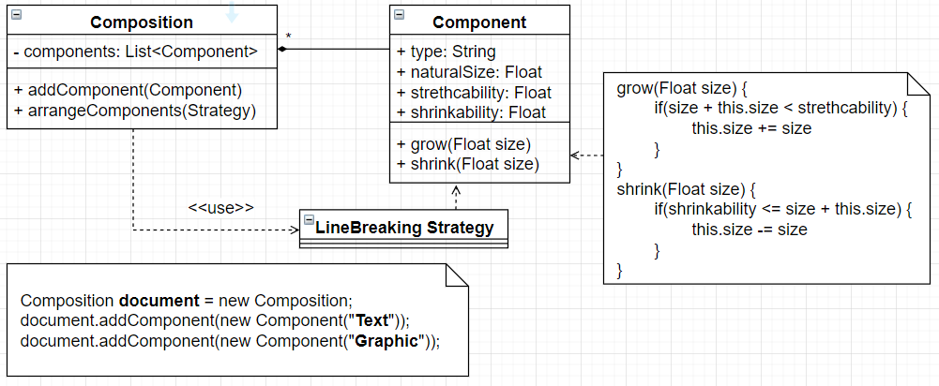
Requirements Statement 4
The stretchability defines how much the component can grow beyond its natural size; shrinkability is how much it can shrink.

Slide 7
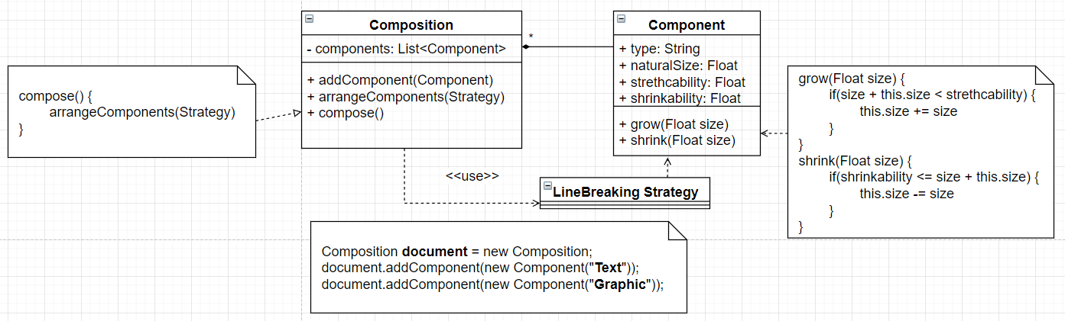
Requirements Statement 5
When a new layout is required, the composition calls its compose method to determine where to place linebreaks.

Slide 8
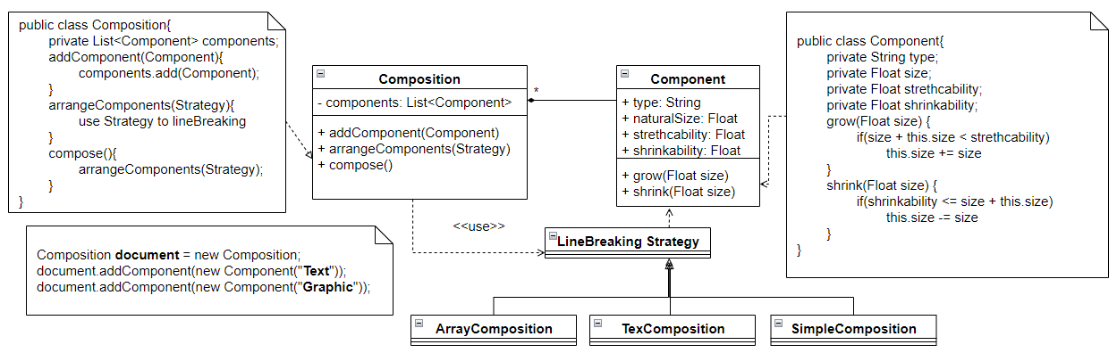
Requirements Statement 6
There are 3 different algorithms for breaking lines:
Simple Composition: A simple strategy that determines line breaks one at a time.
Tex Composition: This strategy tries to optimize line breaks globally, that is, one paragraph at a time.
Array Composition: A strategy that selects breaks so that each row has a fixed number of items. It's useful for breaking a collection of icons into rows, for example.

